Slide 1

16-bit RO Physical Unclonable Function ---EEL4720 Final Project
Shida yang
Beichen Su

Slide 2
Table of Content
Introduction to the application
Design and Implementation
Testing and demonstration
Test Results
Problem Encountered

Slide 3
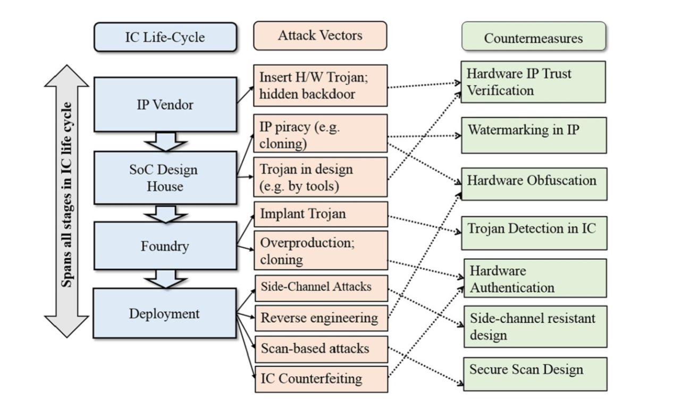
Introduction
Nowadays, people rely more and more on their digital devices, which stored so many important privacy information like radio-frequency identification (RFID). Hardware security is becoming increasingly important.
Our application is mainly focused on hardware authentication

Slide 4
Introduction
In traditional methods, secret keys are stored digitally in a nonvolatile memory which is always vulnerable based on hardware implementation and key storage.
For extremely resource contained platform such as radio-frequency identification (RFID), even simple cryptographic operations can be too costly.
Software-only protection is not enough. Non-volatile memory technologies are vulnerable to invasive attack as secrets always exist in digital form.
adversaries can physically extract secret keys from EEPROM while processor is off
Due to the differences between each devices (length, width, oxide thickness) in circuit and system (Process Variation), each IC has unique properties.

Slide 5
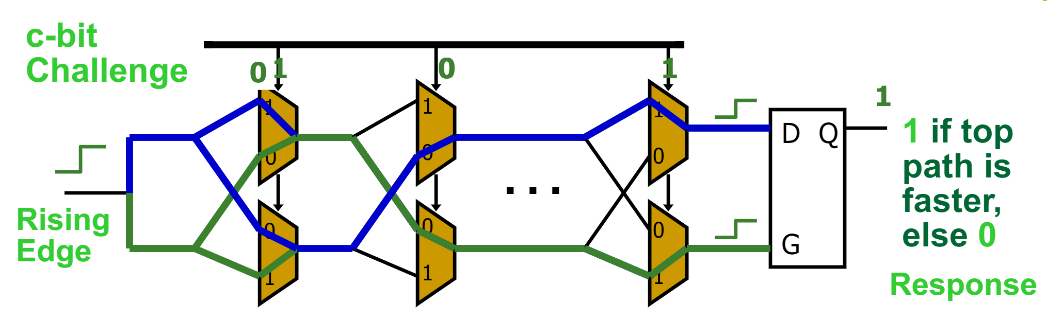
Introduction
Physical Unclonable Function (PUF) is a function that is:
Based on a physical system
Easy to evaluate (using the physical system)
Outputs looks like random function
Unpredictable even for an attacker with physical access
Path delays in an IC are statistically distributed due to random manufacturing variations

Slide 6
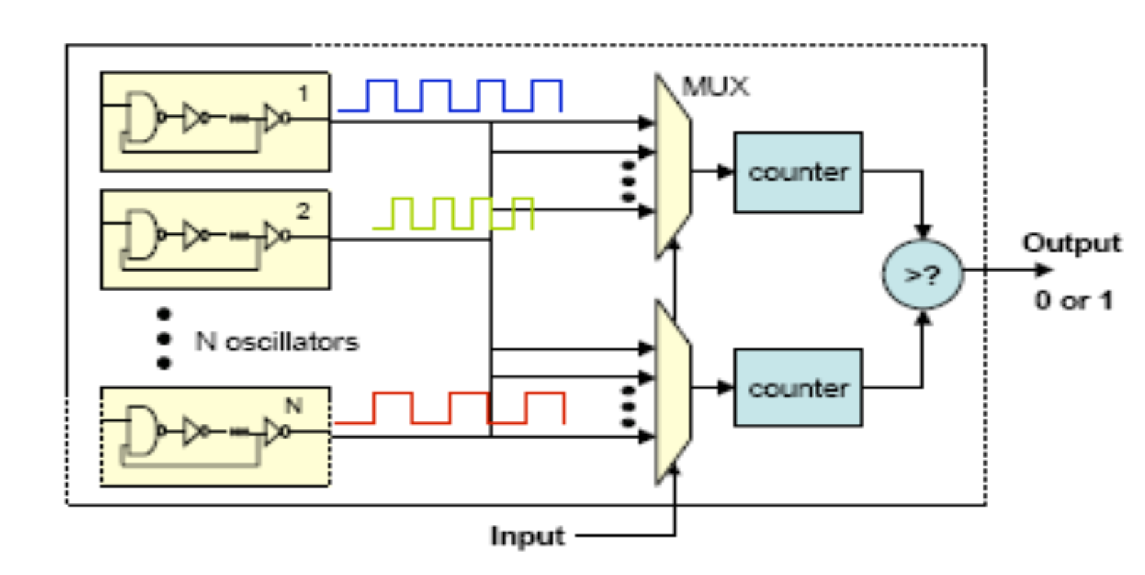
Introduction
Ring-Oscillator (RO) PUF replies on delay loops and counters instead of MUX and arbiters because it will be more stable on FPGA.
Our design is implementing a 16-bit RO PUF. Input (Challenge) is 16 bit and the output is 1 bit. We store 32 different 16-bit challenges, generated by a random generator function, in RAM and pass through all challenges one by one to form a 32-bit response sequences.

Slide 7
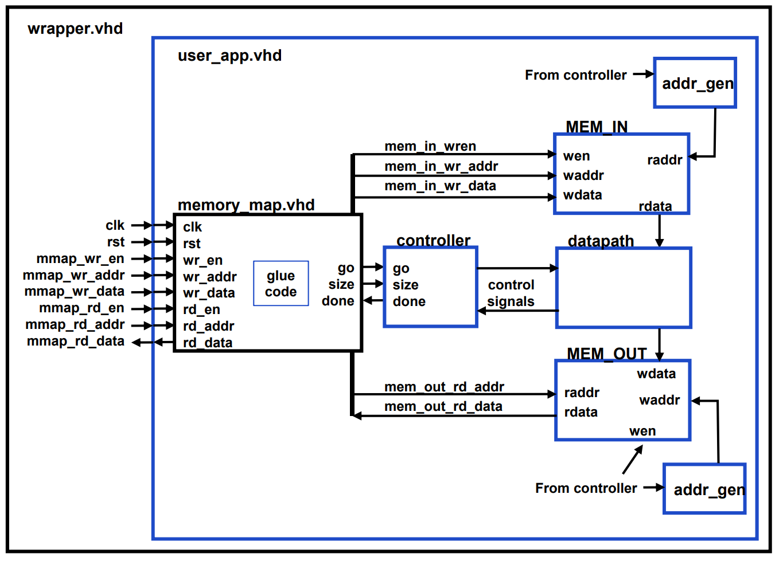
Design and Implementation

Slide 8
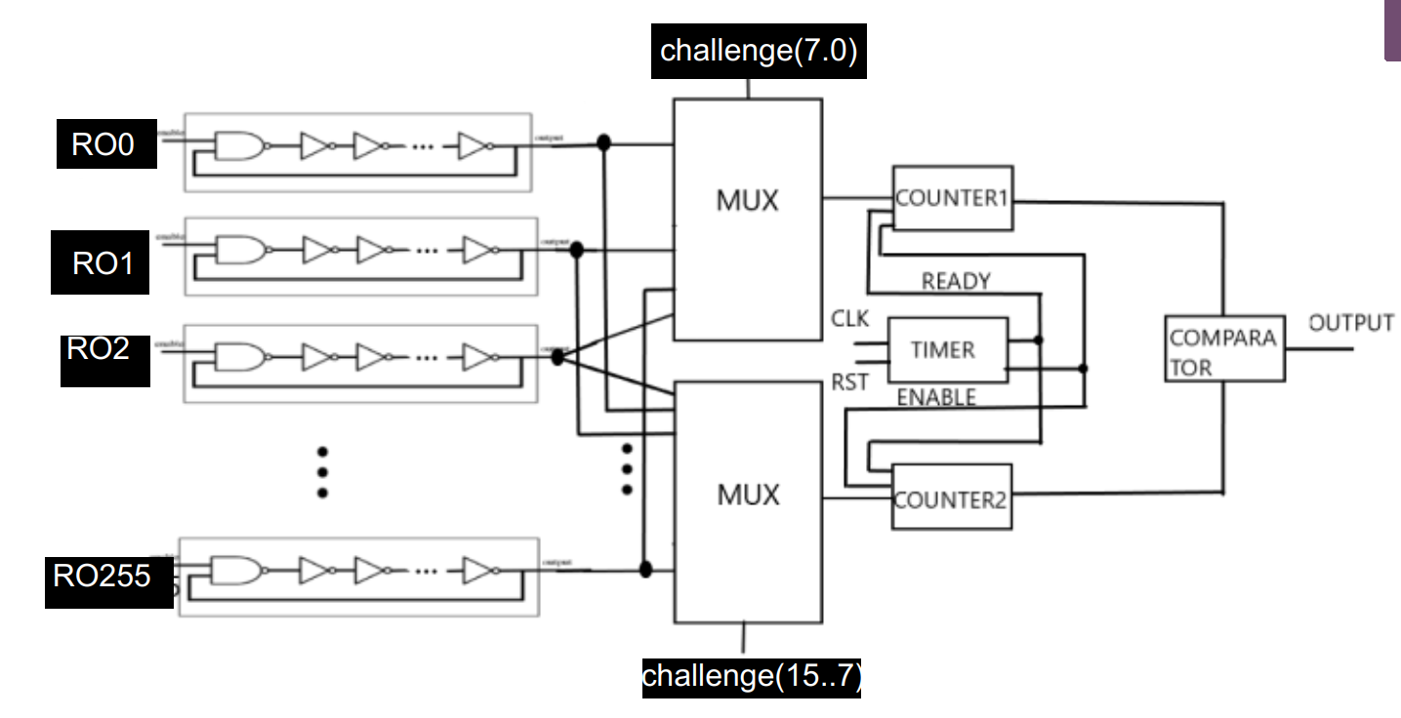
Design and Implementation

Slide 9
Test and Demo (Method and Goal)
We will use intra-Hamming Distance and inter-Hamming Distance to test our design.
What is Hamming Distance?
Given two numbers, calculate the fraction of bits that are different
For example, use two 8-bit number
0b11001010
0b10001011
2 different bits, so HD=2/8=0.25

Slide 10
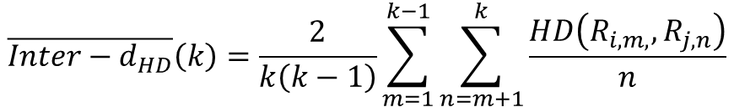
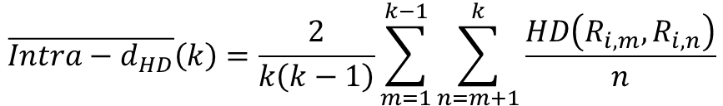

Test and Demo (Method and Goal)
Intra-HD
Give same set of input to the same chip multiple times
Compare the HD between the outputs
Tells how reliable the design is
Ideally close to 0 because a reliable design should have the same output for the same input
Inter-HD
Give same set of input to different chips
Compare the HD between the outputs across chips
Tells how unique each chip is when implementing the same design
Ideally close to 0.5 because each bit has two possible outcomes, so half of the bits should be different on average
$$\overline{Intra−d_{HD}}\left(k\right)=\frac{2}{k\left(k−1\right)}\sum_{m=1}^{k−1}{\sum_{n=m+1}^{k}{\frac{HD\left(R_{i, m}, R_{i, n}\right)}{n}}}$$
$$\overline{Inter−d_{HD}}\left(k\right)=\frac{2}{k\left(k−1\right)}\sum_{m=1}^{k−1}{\sum_{n=m+1}^{k}{\frac{HD\left(R_{i, m,}, R_{j, n}\right)}{n}}}$$
$$R_{x, y}=y^{th} response of board x$$

Slide 11
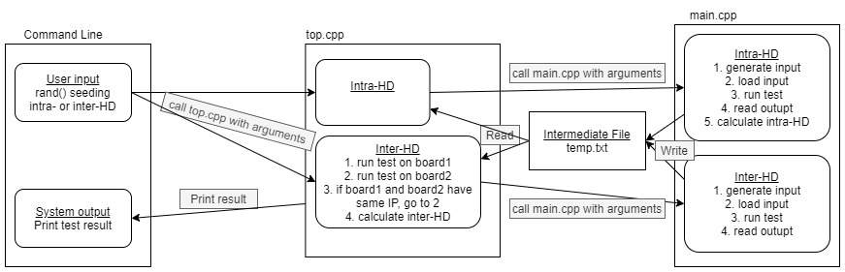
Test and Demo (Data and Control Flow)

Slide 12
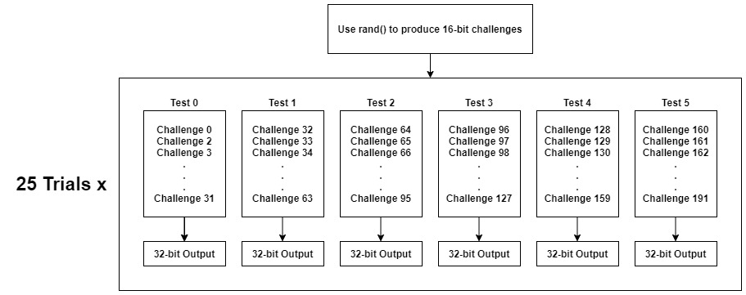
Test and Demo (main.cpp – Input/Output)

Slide 13
Test and Demo (main.cpp – Intra-HD)
25 outputs in the same test from 25 trials
Output 0 ~ Output 24
Pairing output (every possible combination)
Output 0 – Output 1, Output 0 – Output 2, Output 0 – Output 3, Output 0 – Output 4, …Output 0 – Output 23, Output 0 – Output 24
Output 1 – Output 2, Output 1 – Output 3, Output 1 – Output 4, …Output 1 – Output 23, Output 1 – Output 24
Output 2 – Output 3, Output 2 – Output 4, … Output 2 – Output 23, Output 2 – Output 24
……
Output 23 – Output 24
For each pair, calculate intra-HD
Find number of different bits (n), divide by total number of bits (32)
n/32
Average the intra-HDs

Slide 14
Test and Demo (top.cpp – Inter-HD)
Keep doing test until get results from two different boards
25 outputs from board 1, 25 outputs from board 2
Pair them up just like in the previous slide
First element in the pair is from board 1, second element is from board 2
For each pair, calculate inter-HD
Find number of different bits (n), divide by total number of bits (32)
n/32
Same algorithm for calculating Hamming Distance, just the pairs are from different boards
Average the inter-HDs

Slide 15
Test and Demo (Command Line)
./top.o RAND_SEED INTRA_OR_INTER
RAND_SEED: make sure the same set of input is given to the board
INTRA_OR_INTER: 0=inter-HD, 1=intra-HD
Printed Result
6 tests, each test is the average of 25 trials

Slide 16
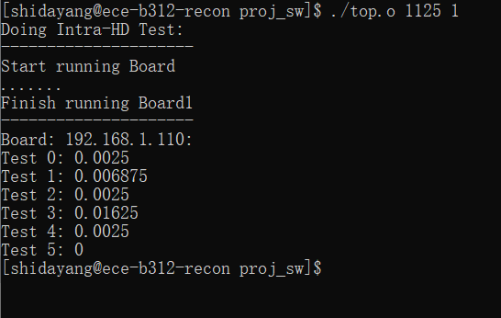
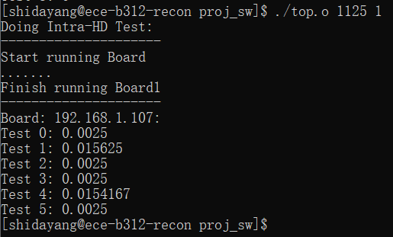
Result (Intra-HD)

Slide 17
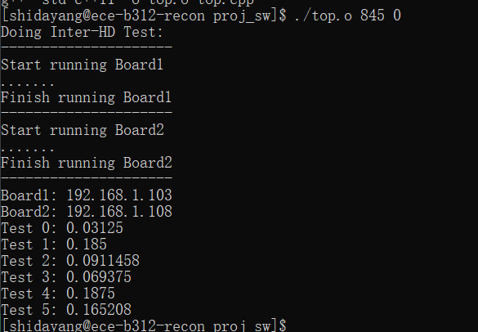
Result (Inter-HD)
The average inter-HDs we measured from our boards are far from ideal
Should be around 0.5 ideally
Our data ranges from 0.03 to 0.18
The implemented design favors certain ROs over others (explained in the next slide)

Slide 18
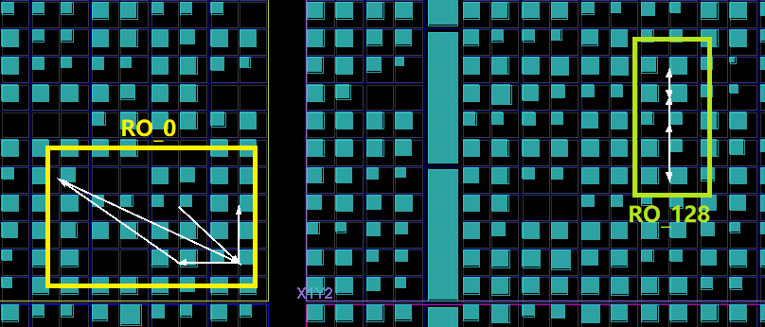
Problem Encountered
Each Ring-Oscillator is routed differently internally
Example: RO_0 and RO_128
RO_0 is in the first mux
R0_128 is in the second mux
Routing lengths are different (RO_128 looks shorter)
If a challenge is 0b1000000000000000
The output would favor second mux in either board
Need to find a way to place internal routing for all the ROs equally

Slide 19
Conclusion
We build a 16-bit Ring Oscillator Physical Unclonable Function with great complexity in both hardware structure and software algorithm, which can be used in hardware security protection in the real world.
Currently it is highly reliable but not so special for each devices, we are satisfied about our progress and result so far.
We will still try to find a way to manipulate the structure of the hardware to make it perfectly match, we hope to get some advice from you.

